Slide 1
Introduction
This internship is a unique opportunity that enables one to apply his analytical skills to make real impact. The internship brings data enthusiast from across the globe to collaborate and work as a team. The primary focus of this internship is the development of an impactful Dashboard that provides insights into user participation on the excelerate platform. The team consists of the following members:
• Debarpita Dasgupta
• Akshay Kumar Sakre
• Samuel Rex Mitra Jeedy
• Daniel Jato
• Rahul Kashyap

Slide 2
• Aniketh Chikle
• Nithiraj N
• Vineet Reddy Madireddy

Slide 3
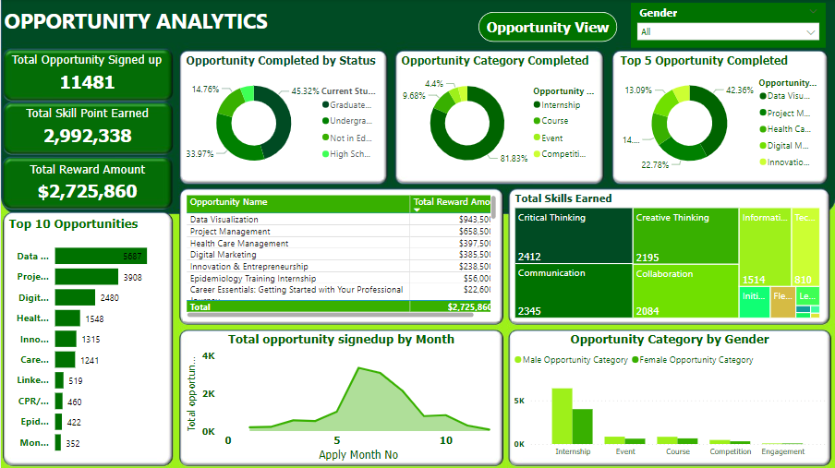
Dashboard Overview

Slide 4
Dashboard Overview
This dashboard was created to extract information from the opportunity wise and user dataset with the aim of providing comprehensive insights into user activity and engagement on excelerate platform.
The dashboard is divided into two separate pages, one for the opportunity wise dataset and the other for the user dataset. Separate pages were created to enhances user experience by facilitating easy access to different types of information in the dashboard. The dashboard also consists of interactive and insightful charts, navigation tab and dropdown filters to refine the search criteria.

Slide 5
Key Decisions and Design Choices
Before the dashboard was created, data preprocessing was accurately in order to ensure the reliability and integrity of the presented insights. Some of the data processing steps taken to refine the dataset involves:
removal of duplicates
converting columns to their appropriate format
handling missing data in columns.
Dashboard wireframe was also created as part of the design choice.

Slide 6
Challenges Faced
One of the major challenges faced was how the information in the dataset will be presented in order to enhance user readability and easy access to the different types of information. After much deliberations with the team, we ended up creating a two pages dashboard for the different dataset.

Slide 7
Solutions Implemented
A two pages dashboard was created. A navigation tab was added for easy access to each of the page. This action facilitates easy access to different types of information and also gave a comprehensive insights.

Slide 8
Insights Derived
The dashboard enables us to know the following
how many people are signed up on the platform
how many of those have signed up for opportunities
the most popular opportunity learners have signed up for
the most popular opportunity learners have completed
the total scholarship and the most gained skills on Excelerate.

Slide 9
Addressing Key Questions
The dashboard aimed to answer the following questions:
How many people are signed up on the platform, and how many of them have signed up for opportunities?
What are the top 10 countries learners have signed up from?
What are the cities in the US learners have signed up from?
Which is the most popular opportunity learners have signed up for?
Which is the most popular opportunity learners have completed?
What is the demographic (gender, student status, etc.) of those who have signed up and completed?
What are the most gained skills on Excelerate and how much is the total scholarship awarded and through which opportunities.

Slide 10
User Interaction and Guidance
Inclusion of Filter Control component to allow users to interactively filter dashboard. it allows users to refine their search criteria effectively. Inclusion of key metrics to create quick insights and addition of navigation tab to ease the flow of information.

Slide 11
Visual Highlights

Slide 12
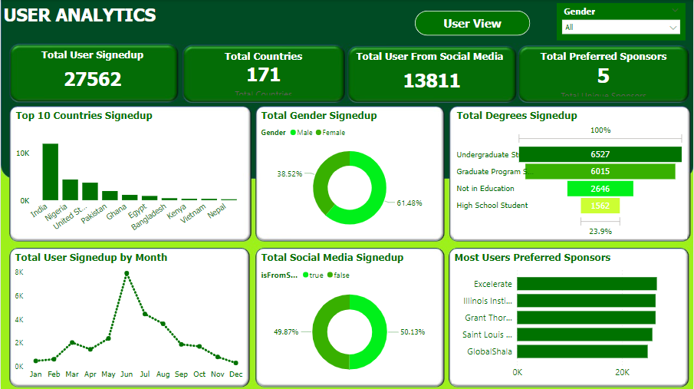
Visual Highlights

Slide 13
Impact on Decision-Making
More awareness should be created especially in countries where participation is low
Rewards for opportunities that records low participation should be increased to encourage more participations across the globe

Slide 14
Thank you

